Slide 1

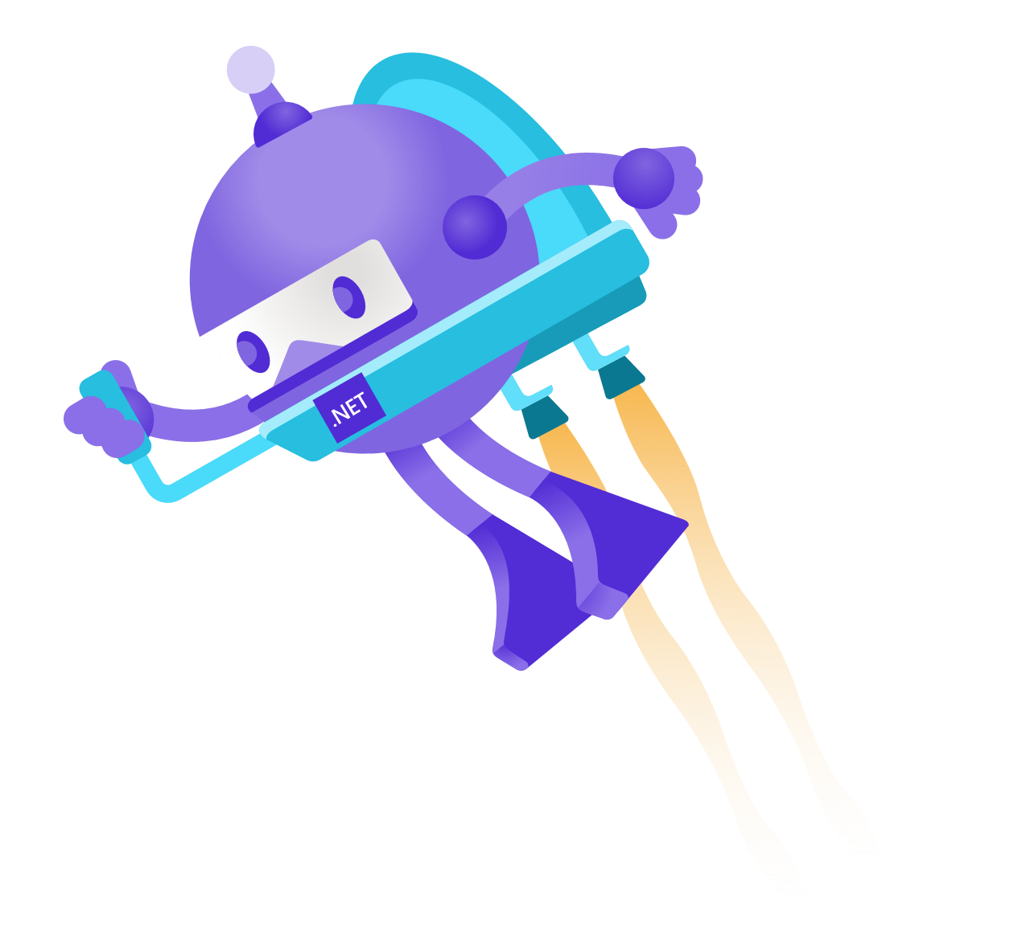
Migrating a Windows Forms App to Blazor: The Amazing and True Story of GIFBot
Georgia Nelson

Slide 2

Who Am I?
BATMAN!
Professional game developer of 18 years
Specialization in client/server application development
Partnered Twitch streamer

Slide 3
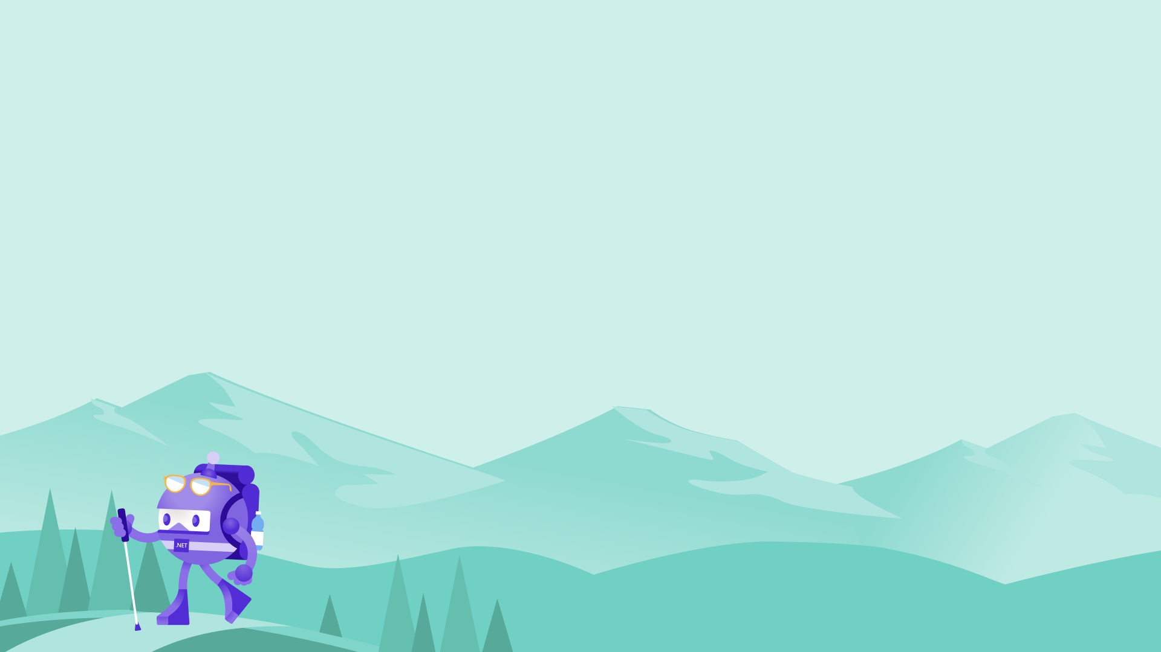
An Introduction to Silly Things like Twitch and Bots

Slide 4

What is Twitch?
An online streaming platform.
Largely created for gaming, but there are categories for science, technology, art, and more!
Has a thriving community full of memes and a mighty need to interact with streamers.

Slide 5
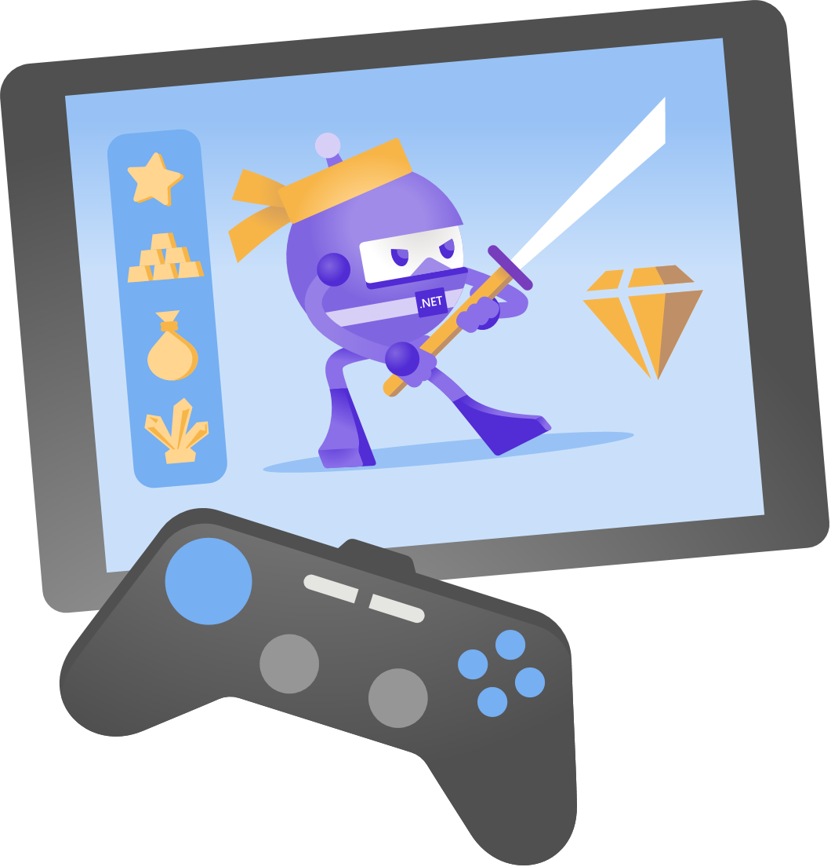
What is GIFBot?
A bot written against the Twitch API that provides streamers with unique and fun interaction opportunities.
Plays animations based on Twitch-specific events or chat interactions.
Has strong roots in the charity streaming community.
Originally written in Java, then moved to C#, and now moved to ASP.NET Core & Blazor.

Slide 6

The Problems
(a.k.a. what C++ engineers create when they move to a managed language)

Slide 7
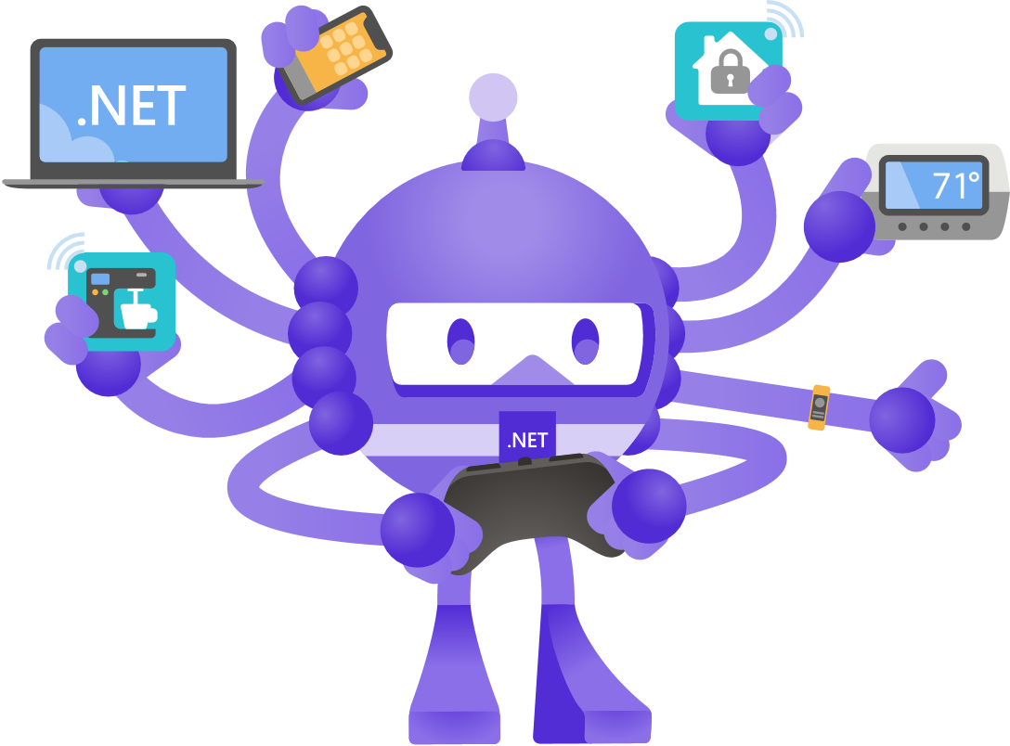
Web-Centric API
Twitch provides a robust API to help developers interact with their platform.
This API is web-centric, meaning it is mostly endpoints and RESTful interactions.
Trying to shoe-horn web-based functionality into a desktop application was a chore.

Slide 8
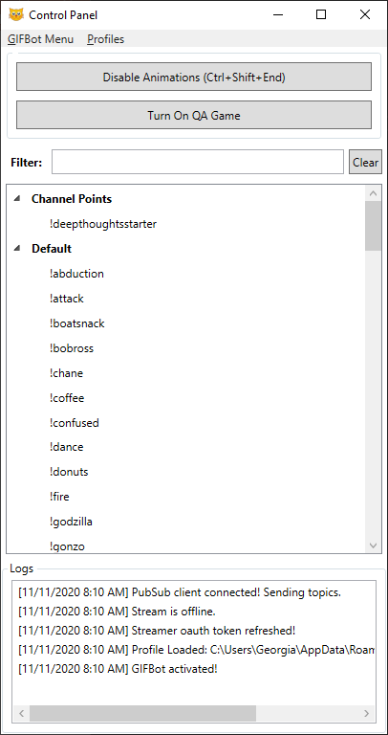
Windows-Only Deployment
WinForms and WPF meant Windows-only deployments.
Longer iteration times to nail down UX and workflows.
Performance implications for gaming streamers.

Slide 9
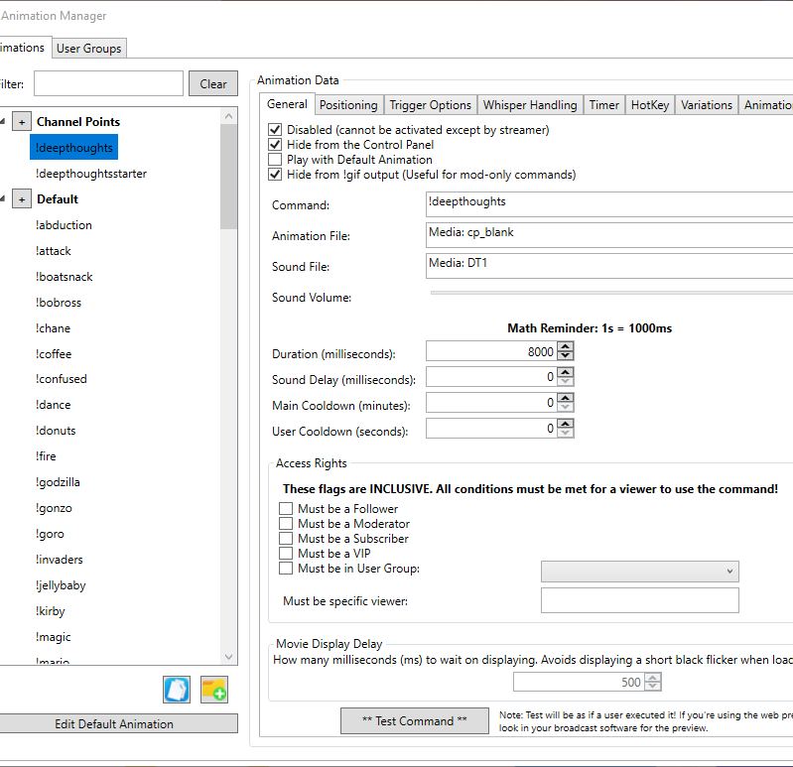
Maintenance Nightmare
To add new functionality required major overhauls to existing systems.
Admittedly, I was new to C# when I first wrote the bot.
Pivoting around changes that Twitch would make to their API made maintenance very difficult due to “clever hacks” in the desktop environment.

Slide 10
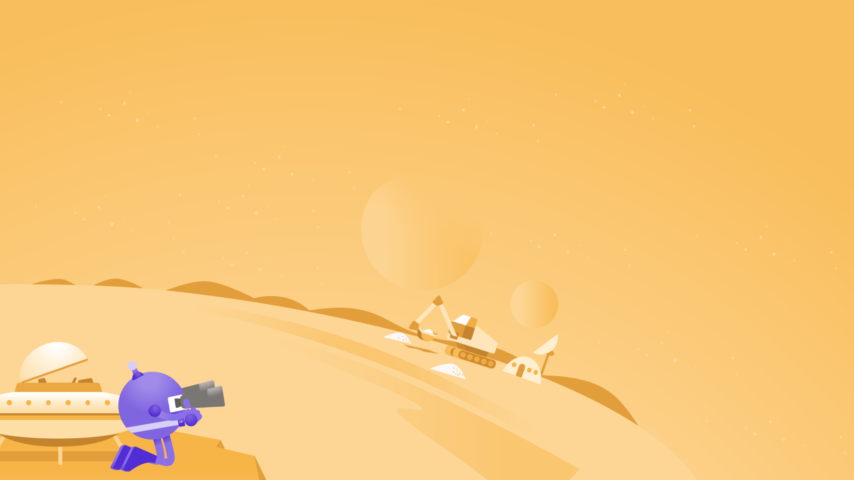
The Solution!
(a.k.a. what a now seasoned C# engineer figured out when she heard there was a somewhat JavaScript-free way of doing things)

Slide 11
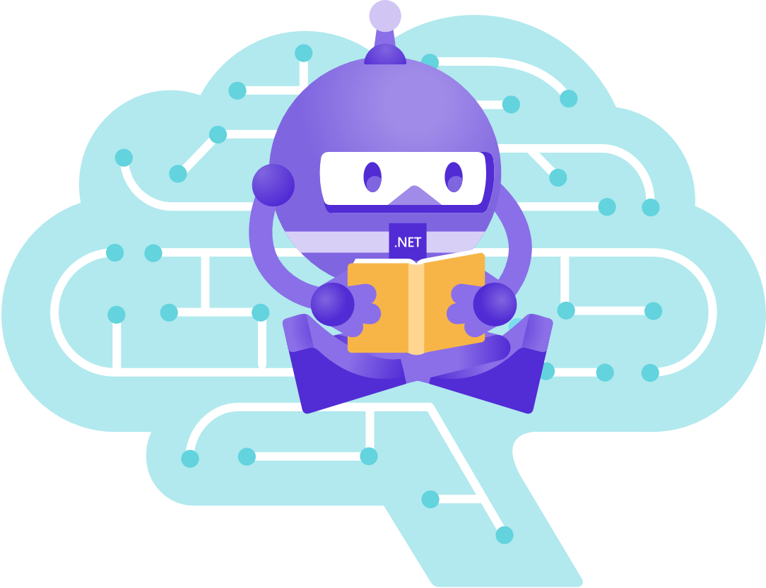
“Web Dev” – An Outdated Perspective
I hadn’t worked in web since 2005 when it was mostly HTML/JavaScript front-end and PHP for the back-end.
Developers needed a tech stack as long as a CVS receipt to “get into” web.
Confusing to know what to learn, what services were required, and what IDEs were best.
I needed something that could self-host. Costs of hosting for my users would be way too high.
Some individuals have animations that are 500mb or higher in size!

Slide 12
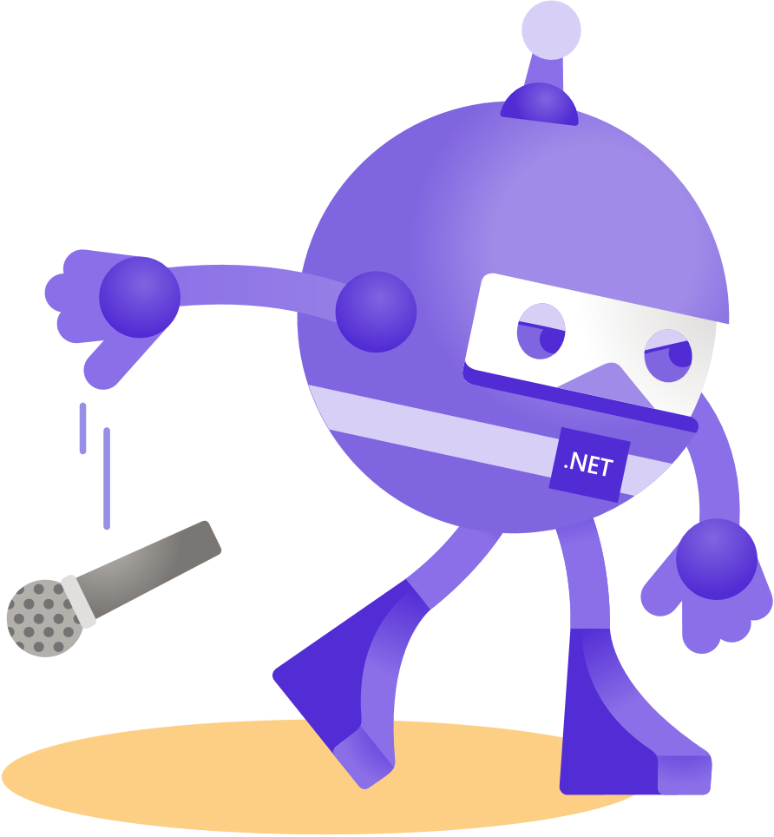
Enter ASP.NET Core and Blazor
C# top to bottom.
Self-hosted options available thanks to Kestrel.
A number of intuitive and proven UI components available on the market.
Similar patterns (MVVM) for developing user-facing applications.

Slide 13
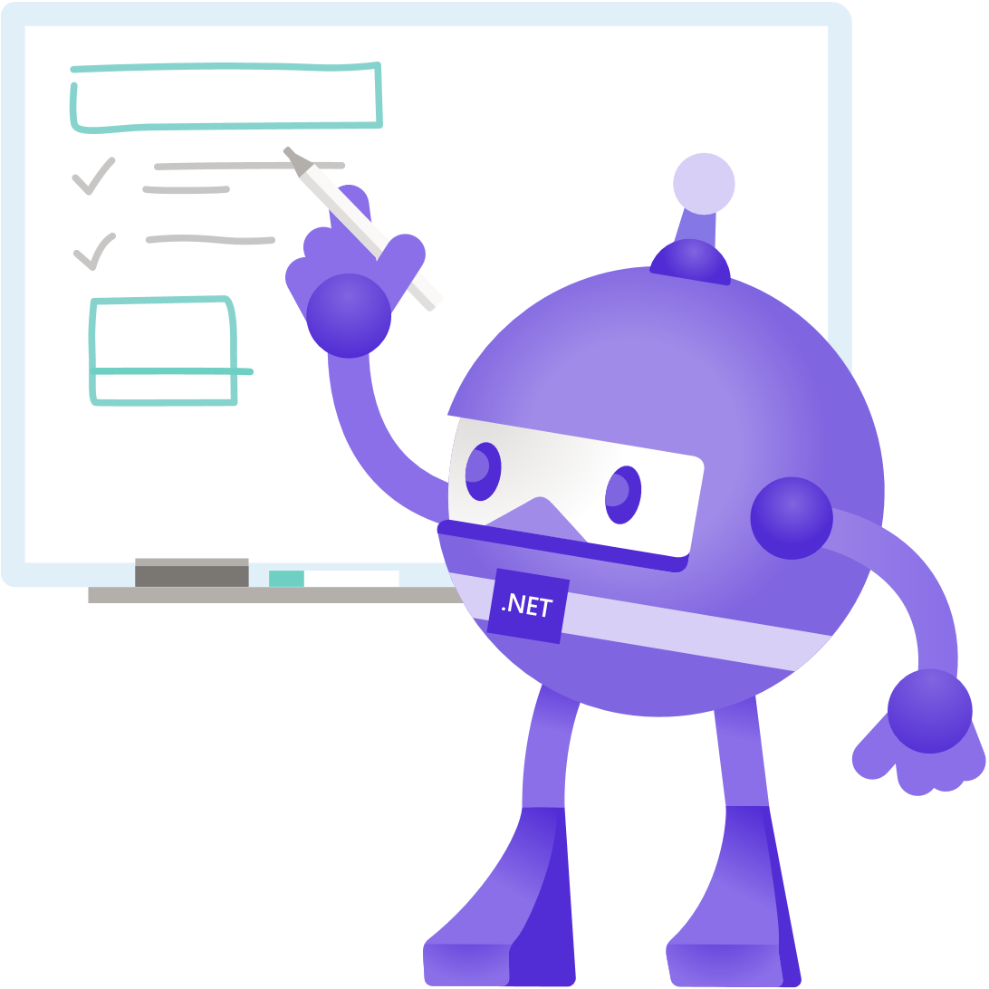
Evaluating Change: A Methodical Approach
Key Question: “If you were to start all over again with the proper tech stack, what would you change?”
Make things much more user-friendly
Wizard-style setup and walkthroughs
Better data organization and formats (json!)
No hacks!

Slide 14
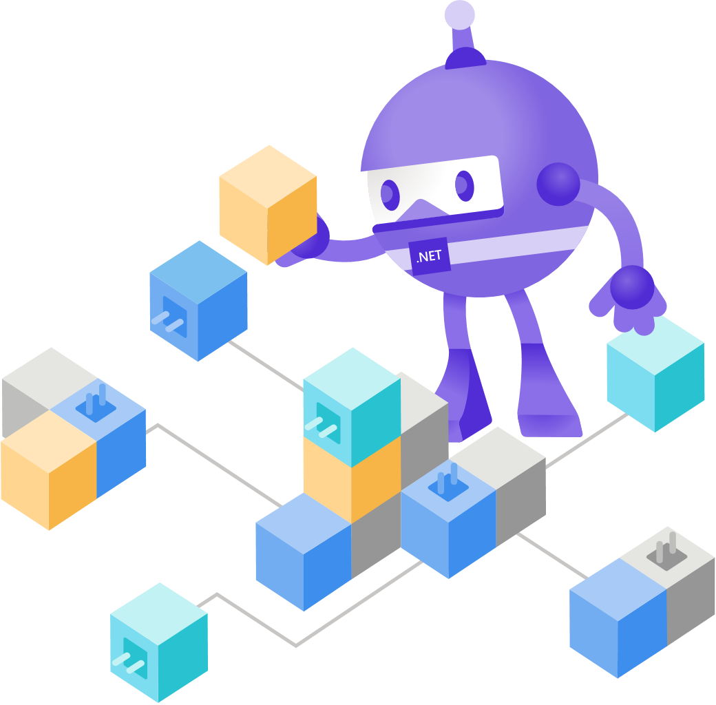
The High Level Solution
Client and Server have bidirectional communication using SignalR.
Endpoint controllers used for RESTful requests that don’t require constant updates.
Telerik Blazor UI Components for faster implementation.

Slide 15
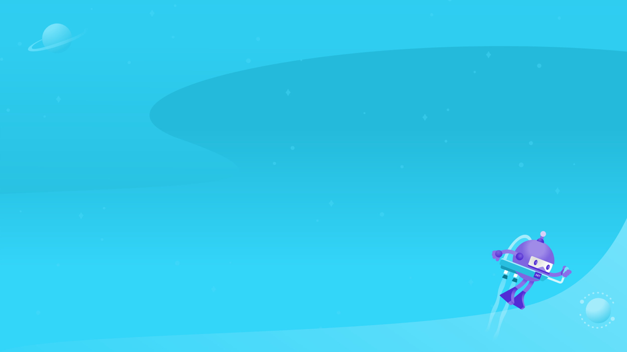
User Friendliness
(a.k.a. what happens when you solicit feedback from real users and don’t develop your UX in a vacuum)

Slide 16
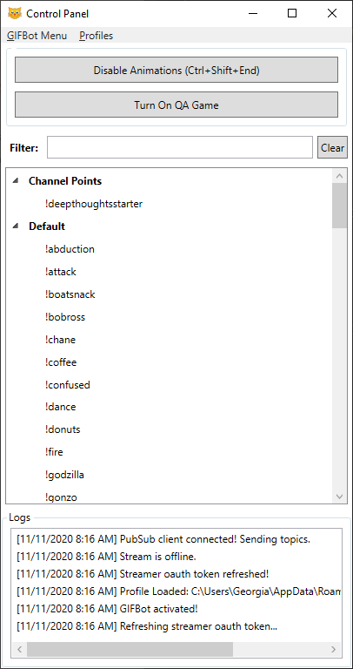

How it Started…

Slide 17

SignalR
Allowed the front-end to receive updates as events happened in streams, giving streamers a real-time view of their interactions taking place.
Streaming large amounts of user data was simple.

Slide 18
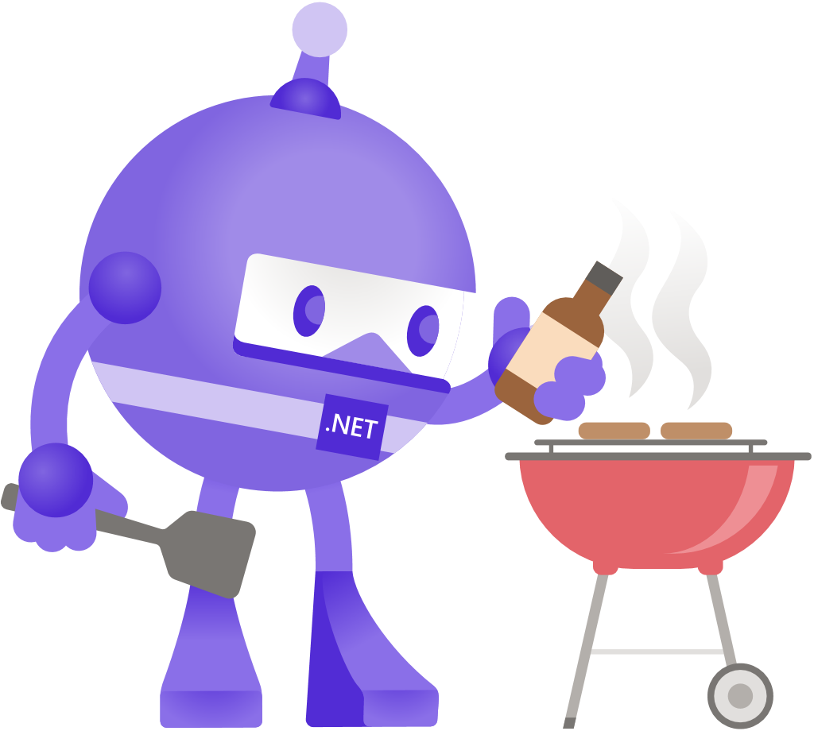
Blazor Components
Telerik Blazor UI
Seamless interaction with large datasets by querying backing data on the server and using SignalR for transmitting results.
Led to a much less frustrating experience for the users, thanks to fast interactions and low loading/wait times.

Slide 19
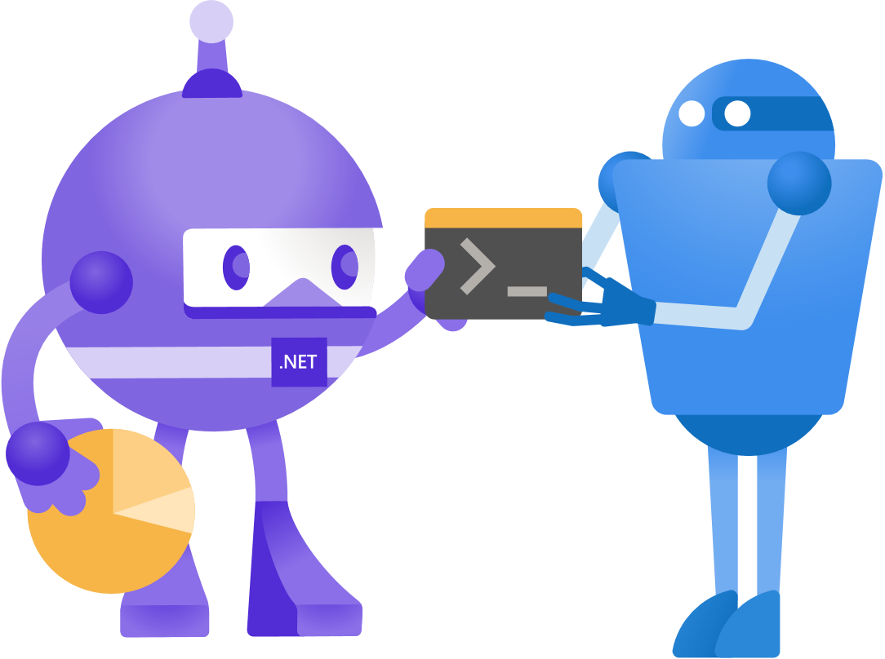
Wizard Style Setup
Detect new installations (first-run) and walk users through setup.
Detect interactions with new systems and present a walkthrough for creation of content.
Easily accomplished in single Razor files with simple state machine implementations.

Slide 20
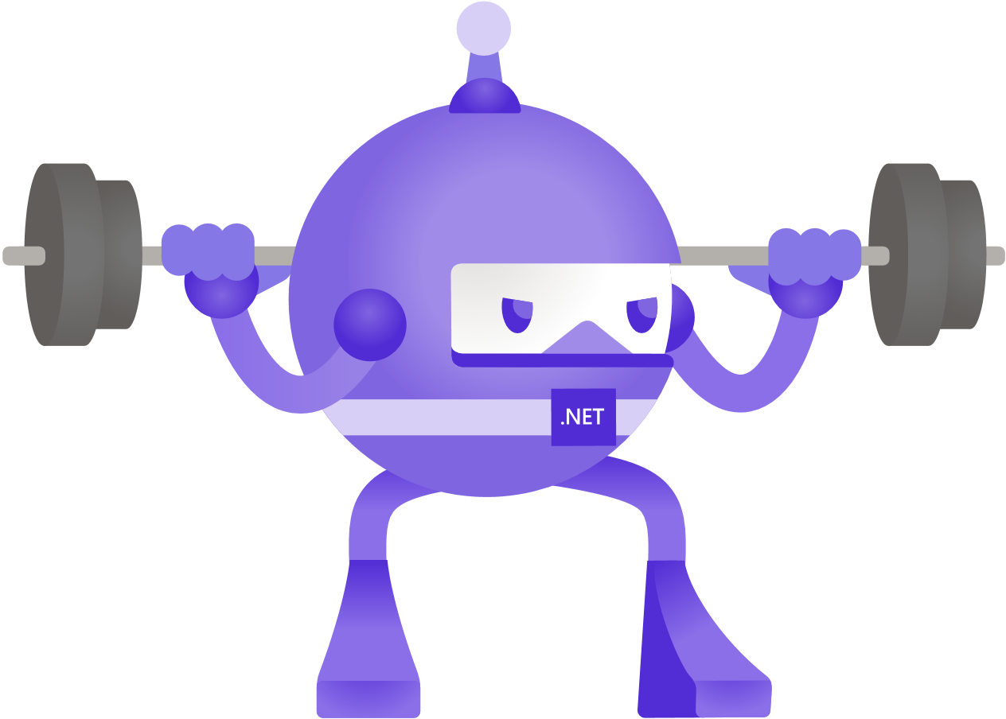
Intuitive Interactions
Sometimes it’s the simple things that we developers unintentionally neglect.
Show/Hide UI elements when they don’t apply.
Reduce friction in interactions.
Split functionality into appropriate sections (tabs, pages, etc.).
Organize data in ways that match the workflow.

Slide 21
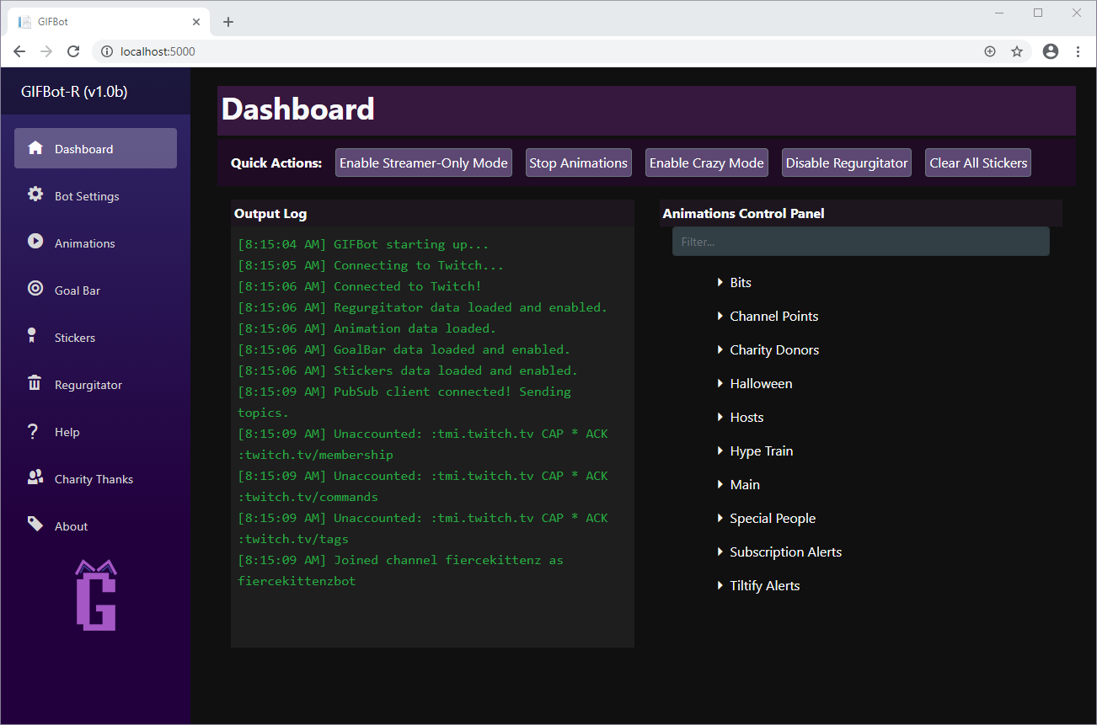
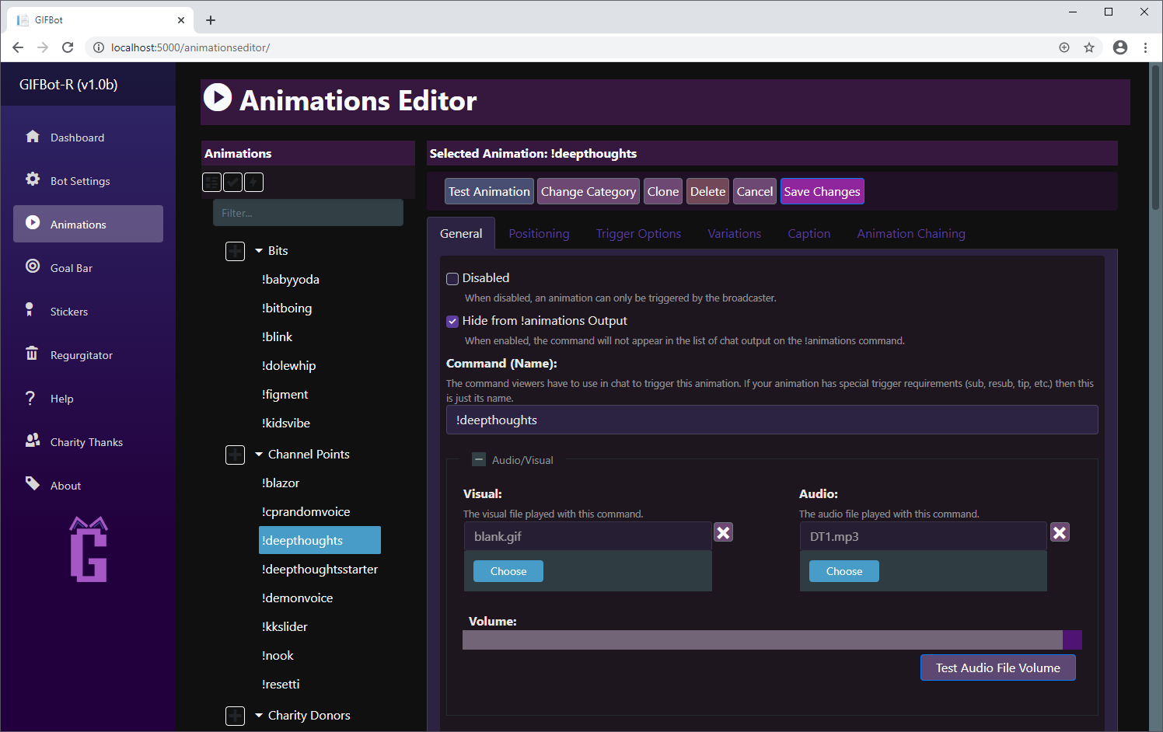
How it’s GOING!!!

Slide 22
Question Time!

Slide 23

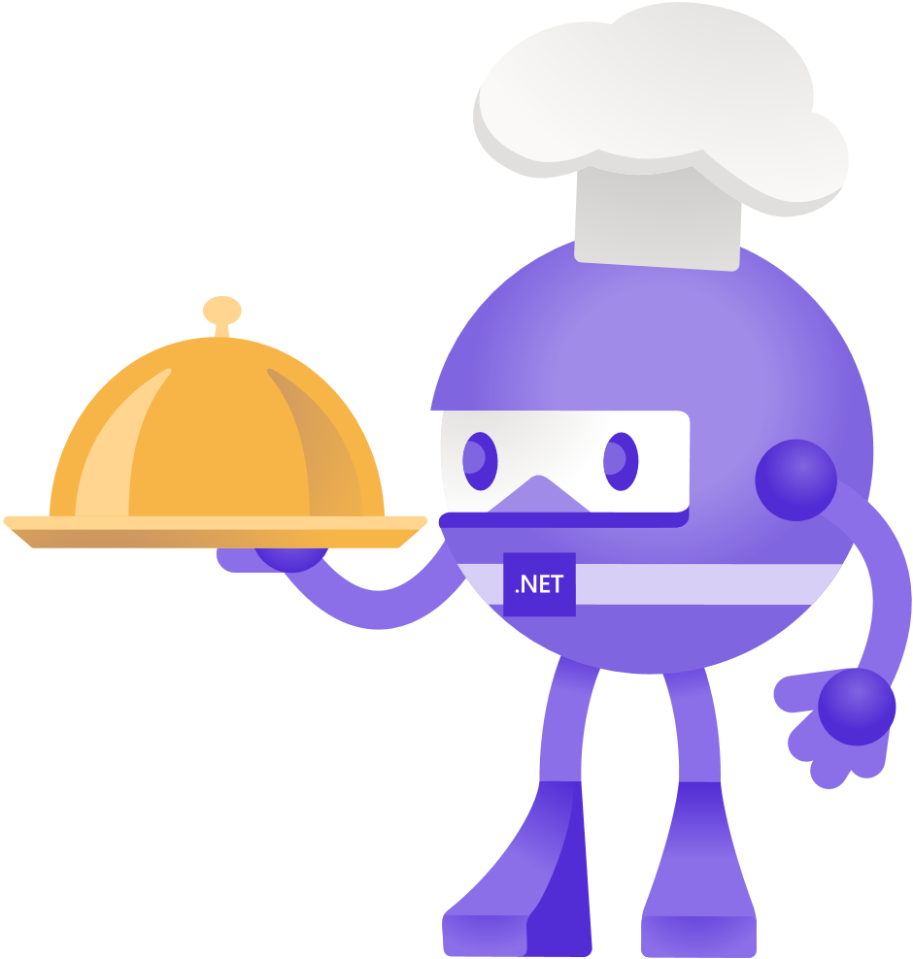
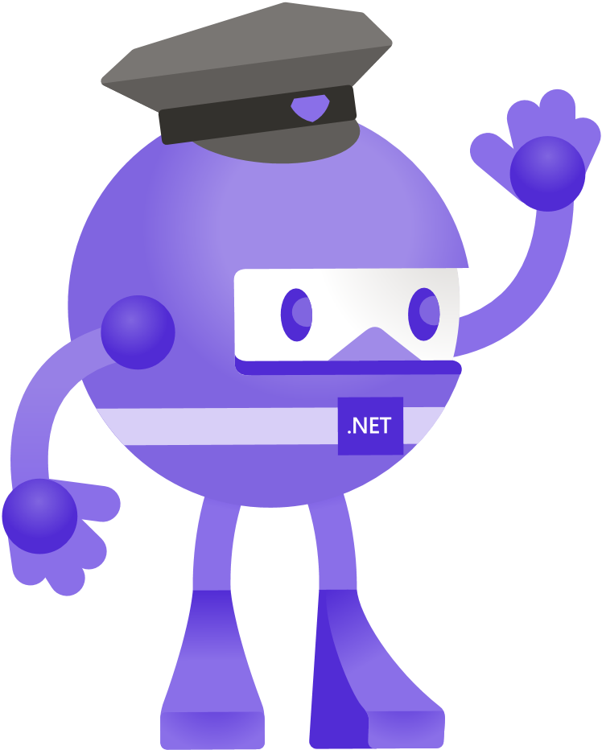

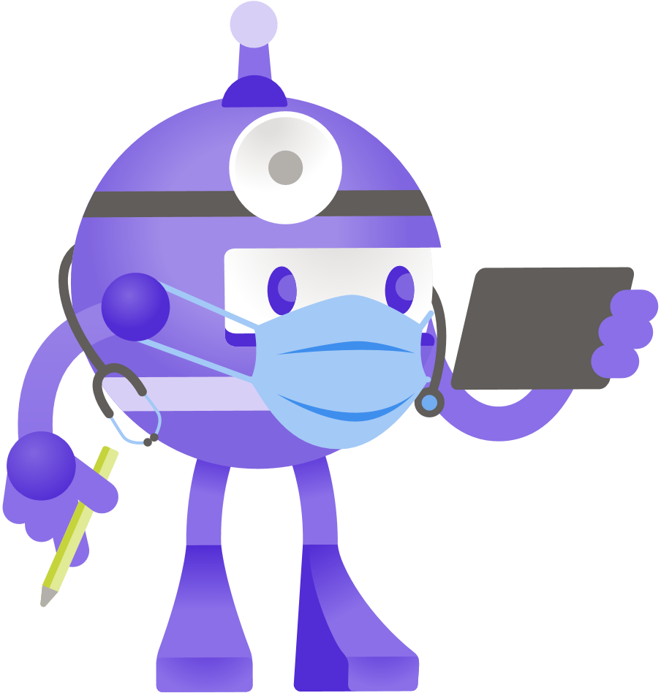
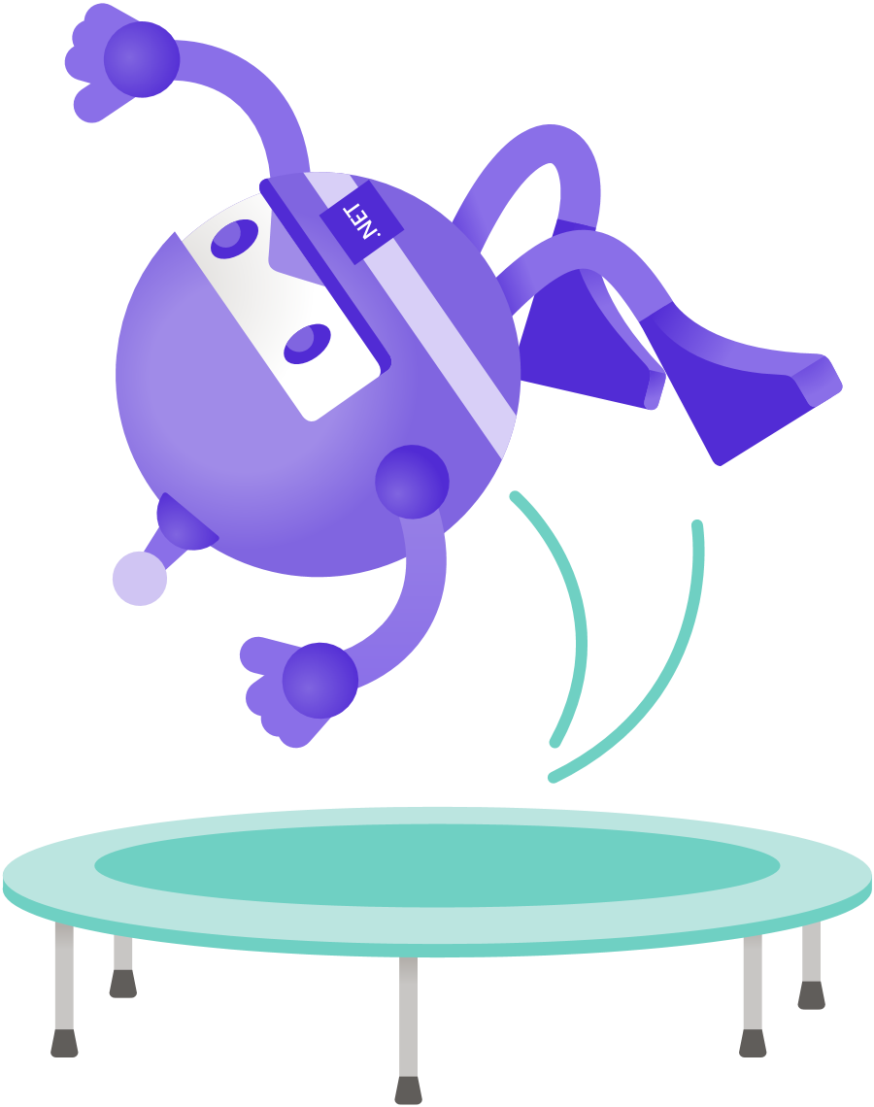
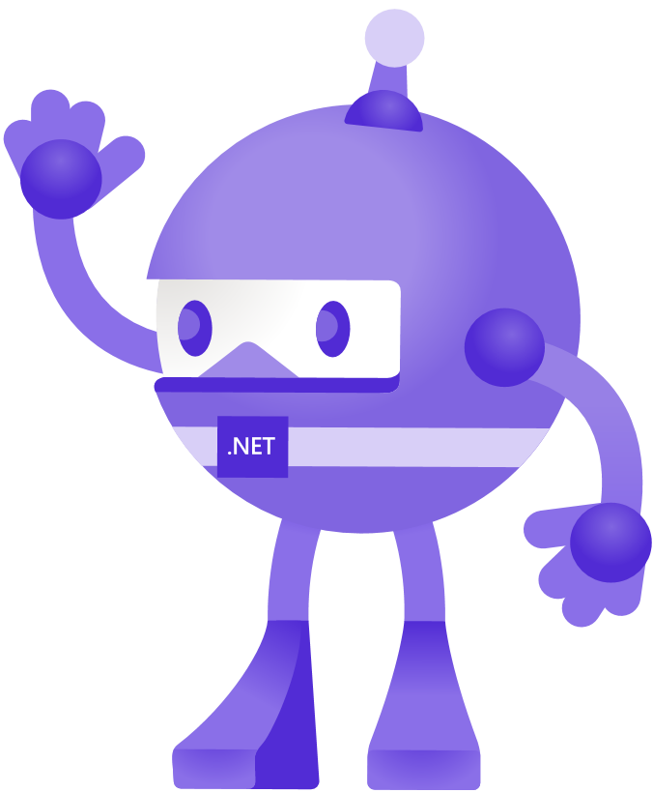


Slide 24

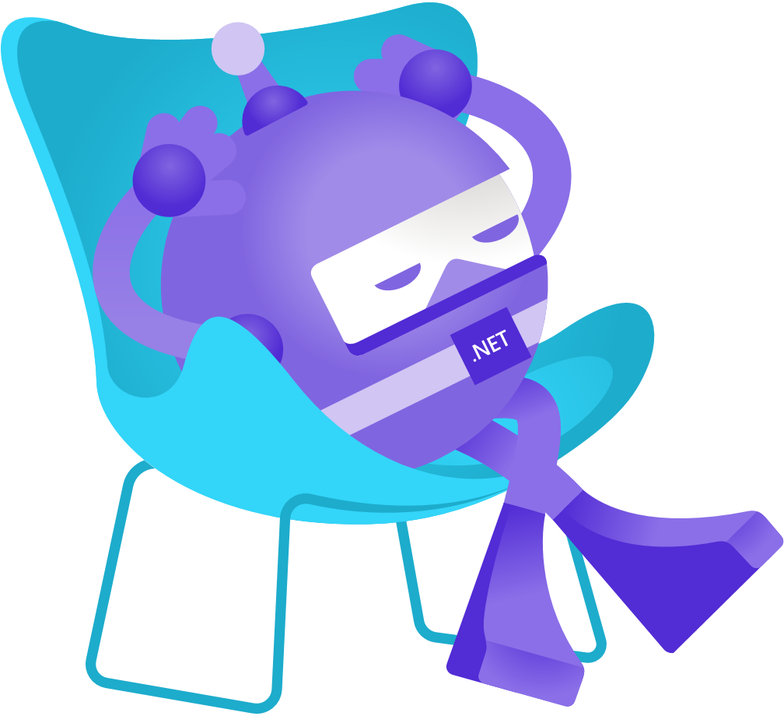

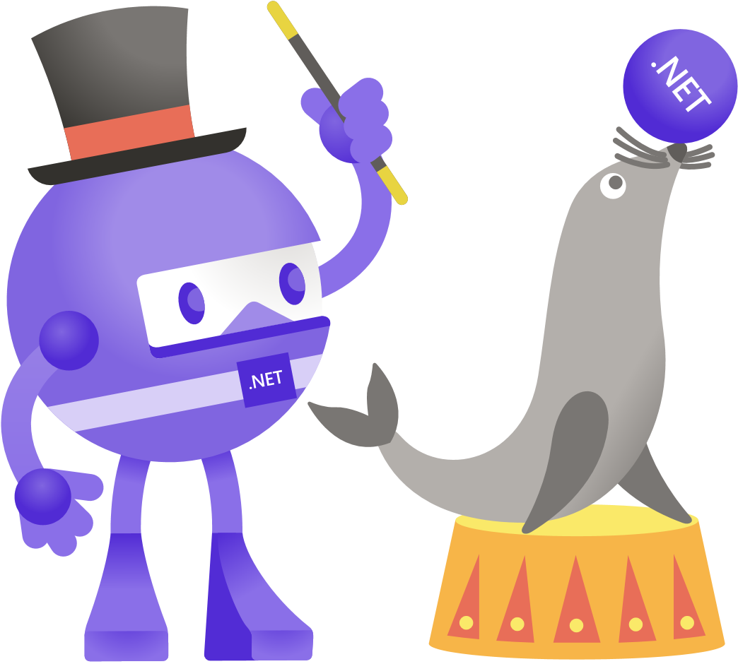


Slide 25

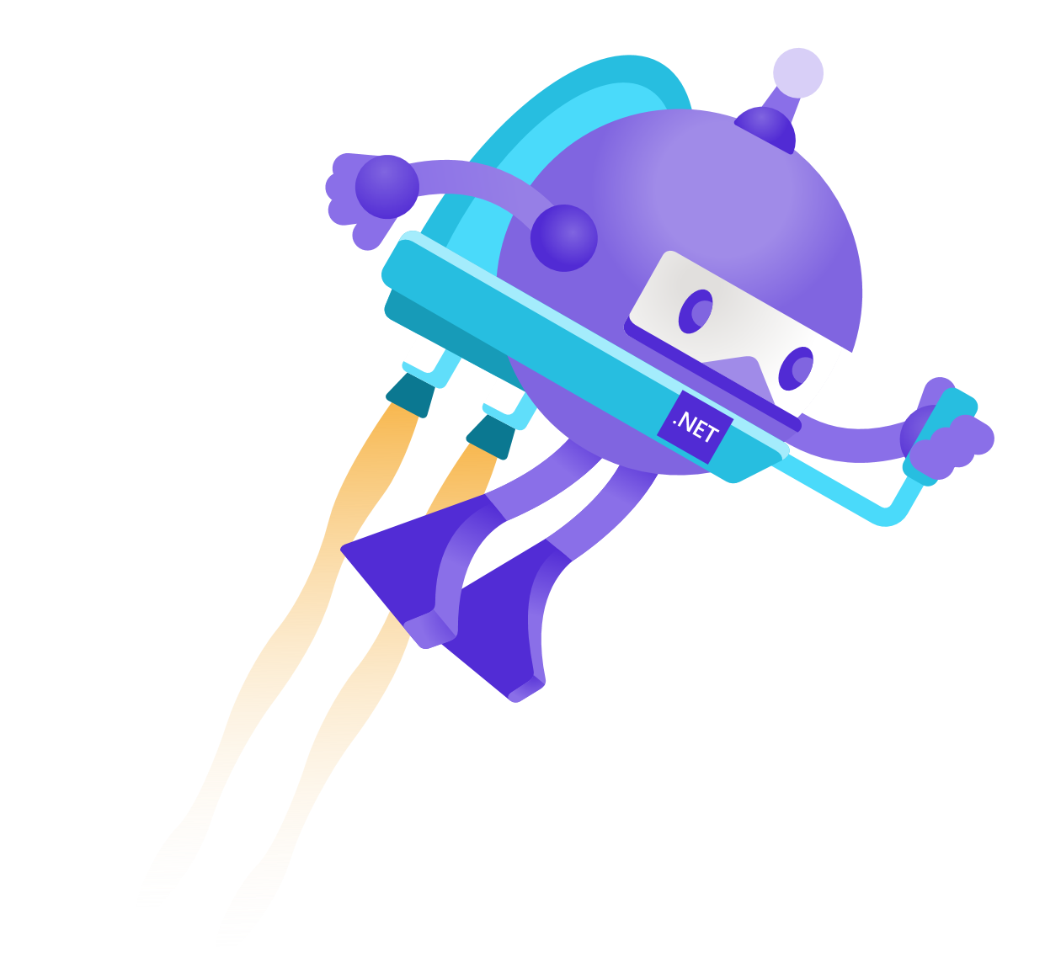
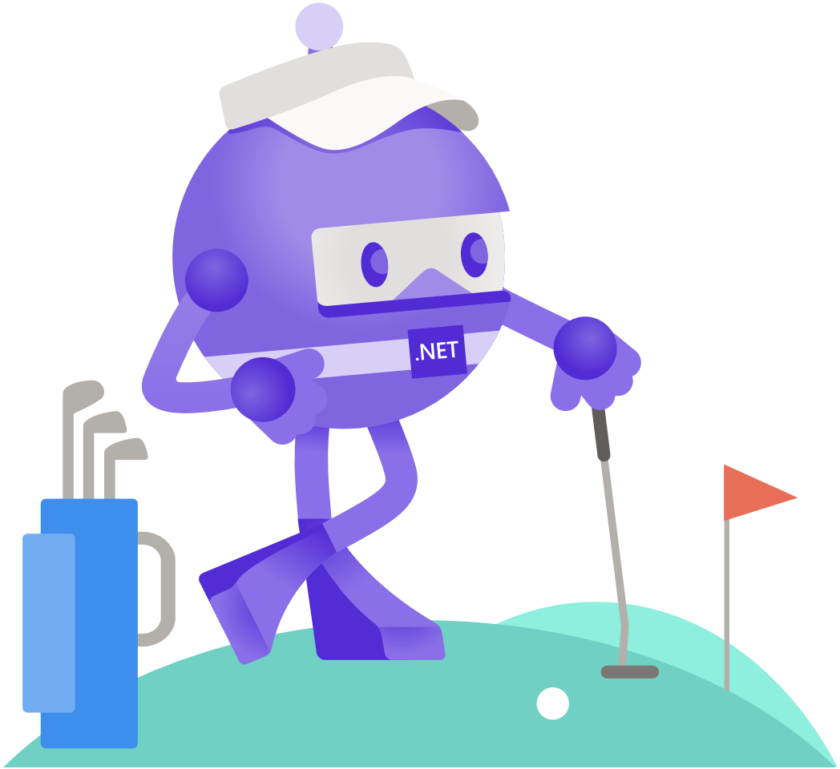
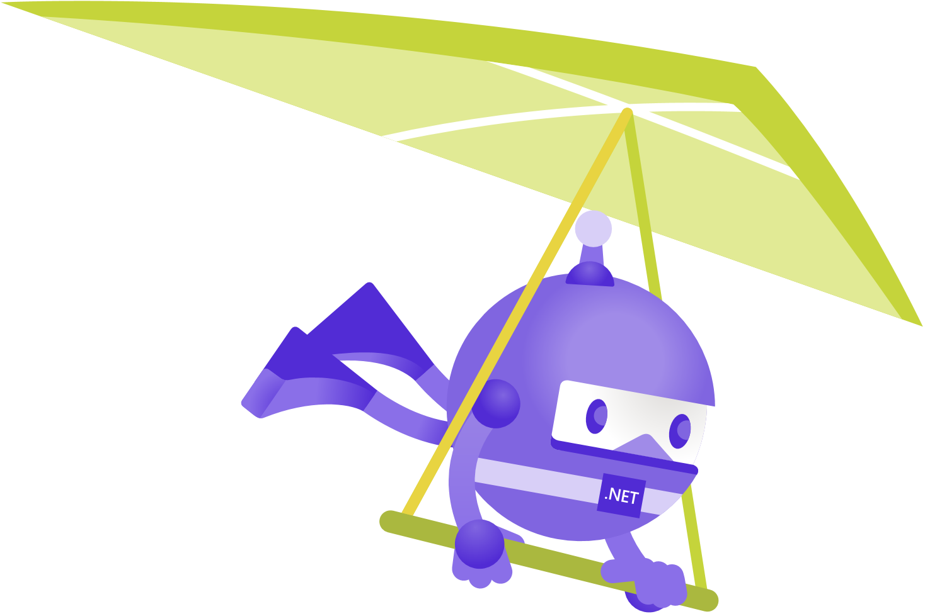
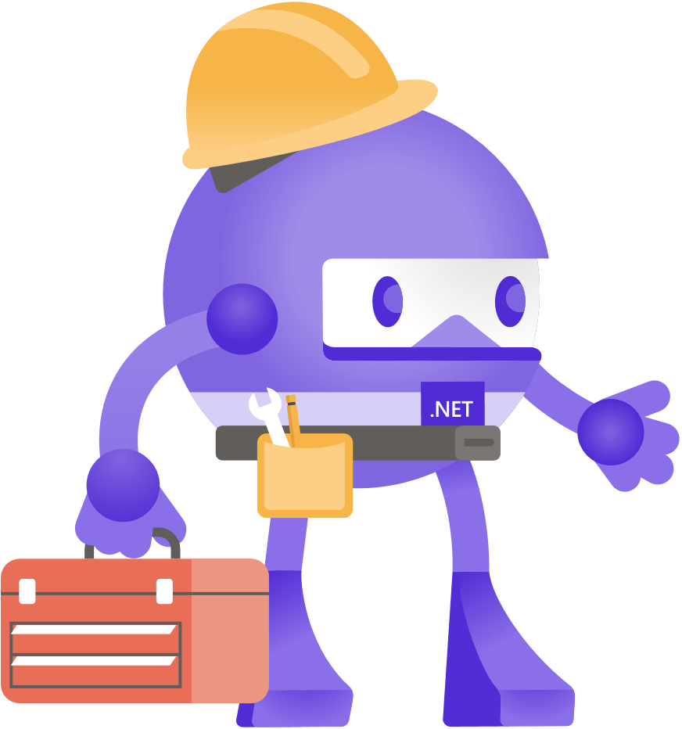
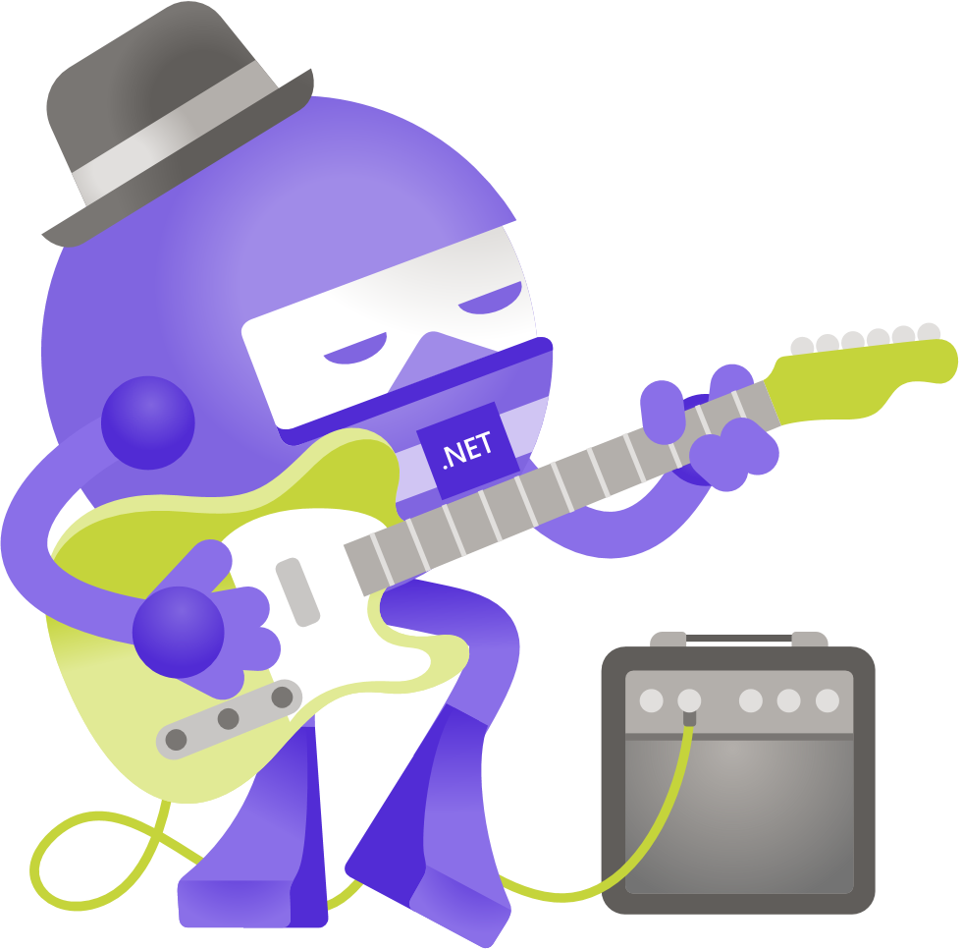

Slide 26
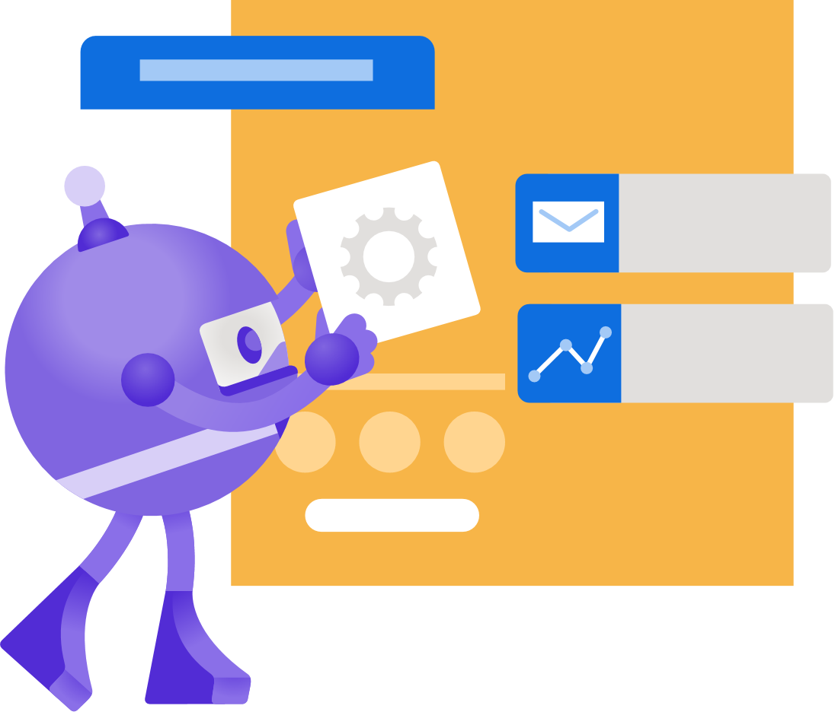
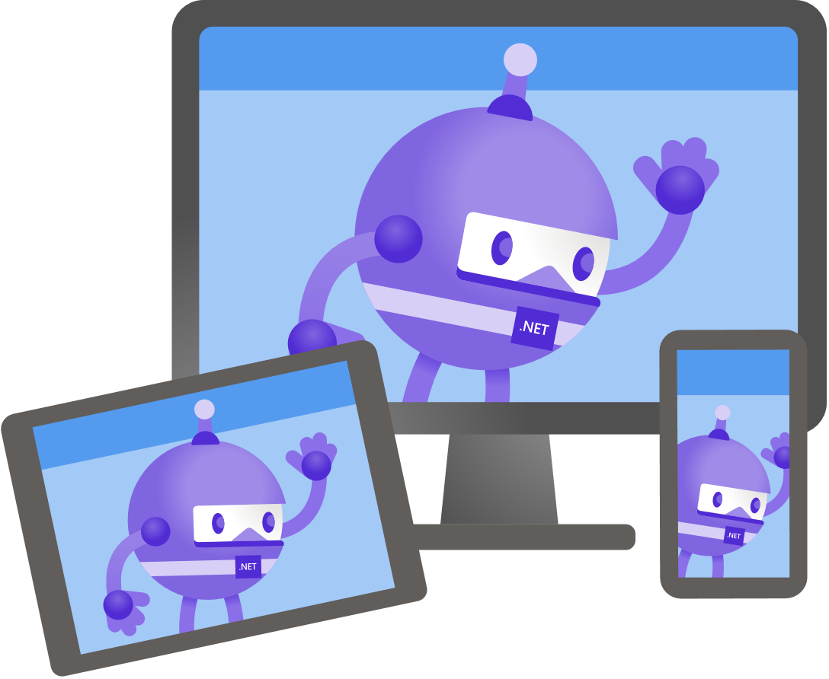

Slide 27
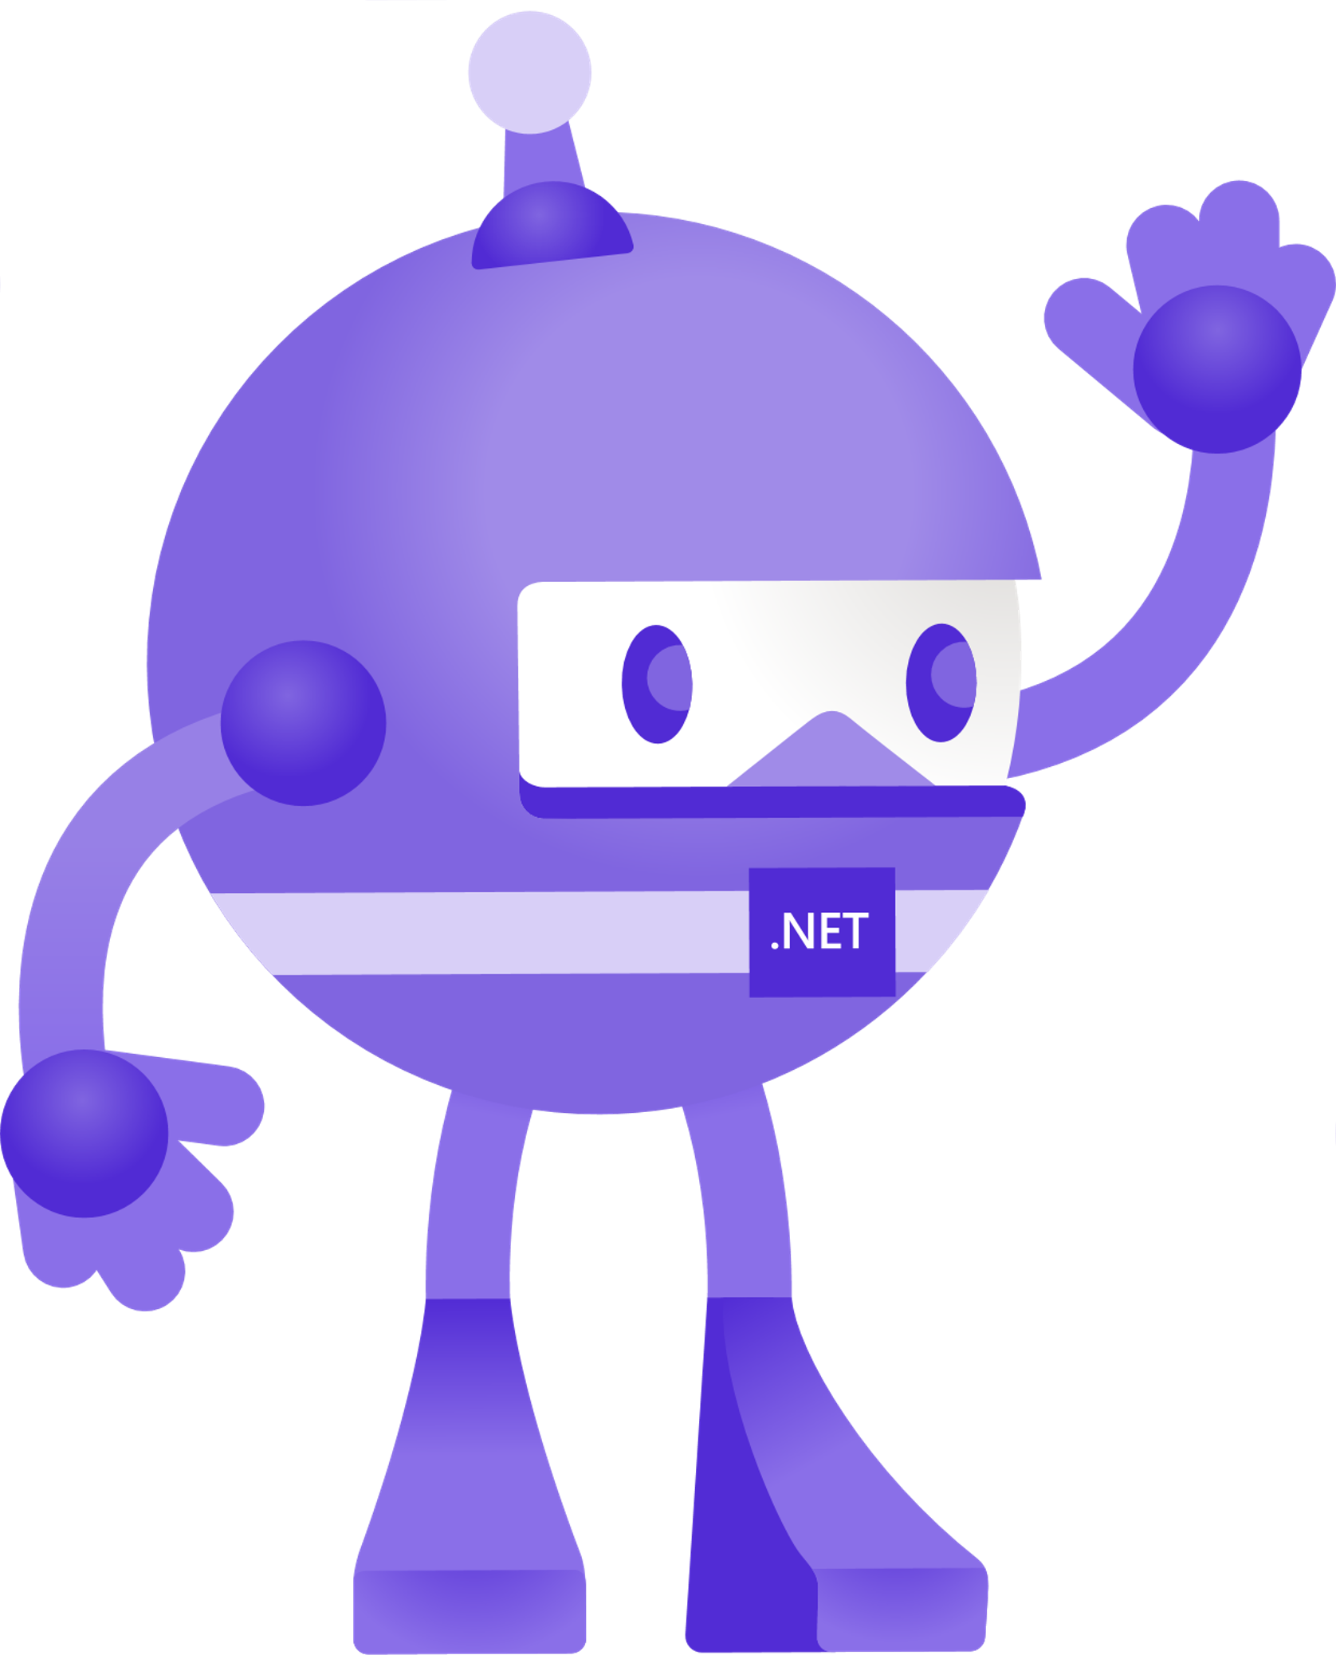

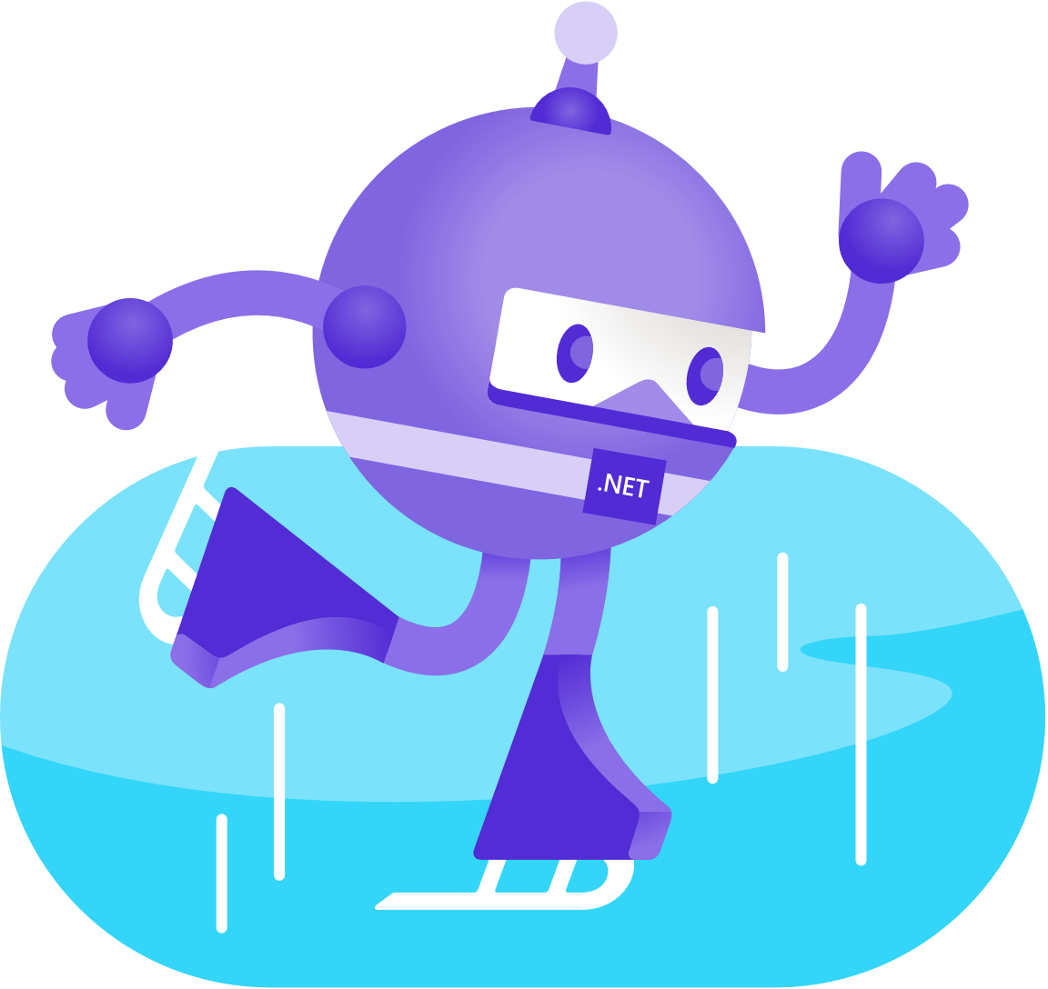


Slide 31
